Slide 1
CUBAN ICT NETWORK UNIVERSITY COOPERATION (VLIRED.CU) “CubaCAS - Boost your research through High Performance Computing”
Dr. Hector Cruz, UCLV, Coo. Local VLIRED.CU
Dieter Roefs, Ghent University, VLIR, Belgium
Universidad 2016, La Habana, Cuba
Tuesday 16 February 2016

Slide 2
Boost your research through High Performance Computing
Vision for Academic Supercomputing in Cuba
What is Supercomputing?
HPC Infrastructure in Cuba: Present & Future
Firsts Results
Get Involved!

Slide 3
Our Vision
'CubaCAS'
Cuban Centre for Academic Supercomputing
“La red Académica de Computación de Alto Desempeño de Cuba"
Geographic distribution of HPC Infrastructure at Havana, Santa Clara and Santiago de Cuba
MES backbone (REDUNIV)
Physical infrastructure at: UCI, UCLV & UO
To make HPC Services available at all Cuban academic and scientific institutions

Slide 4
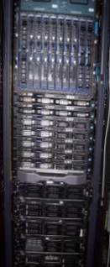
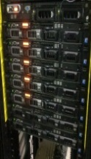
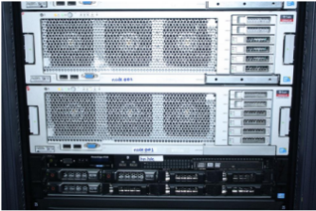
Centers with HPC infrastructure
2015

Slide 5
HPC services for everybody

Slide 6
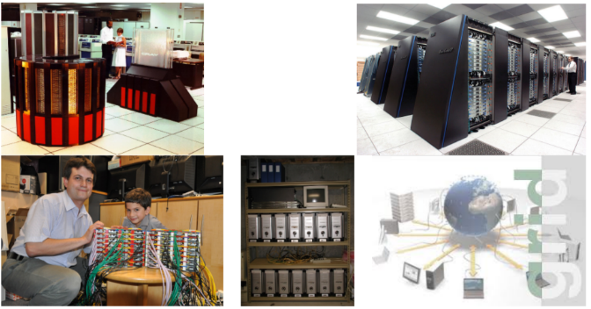
What is Supercomputing?
Parallelism, GRID Computing, High Performance Computing (HPC), Cluster CPU/GPU/BigData,...

Slide 7
Scientific Applications of HPC (1/5)

Slide 8
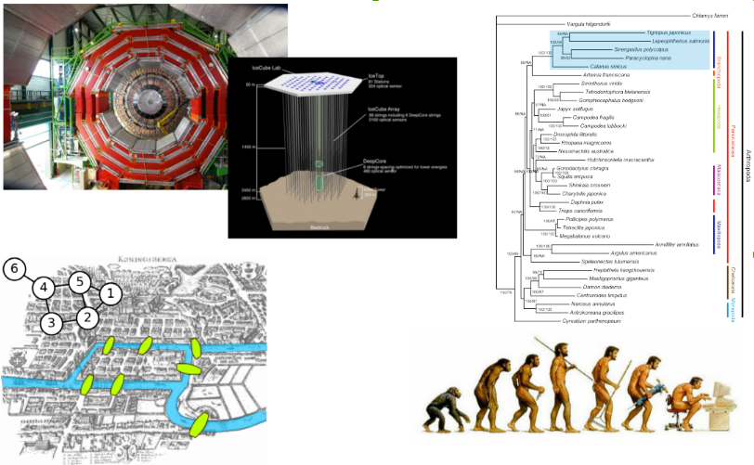
Scientific Applications of HPC (2/5)

Slide 9
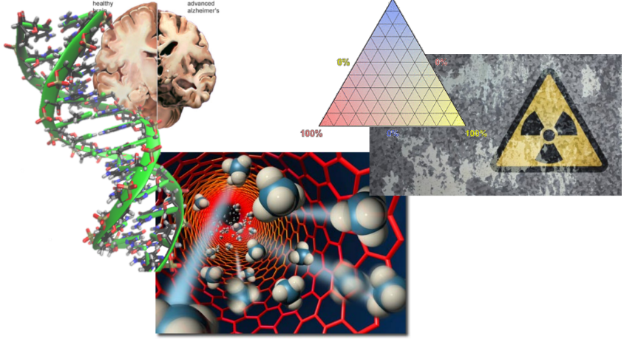
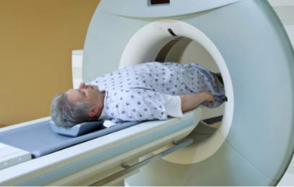
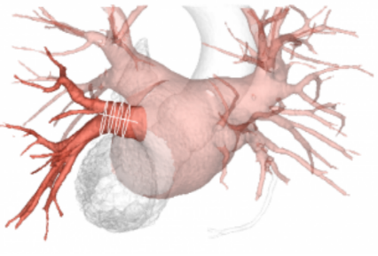
Scientific Applications of HPC (3/5)

Slide 10
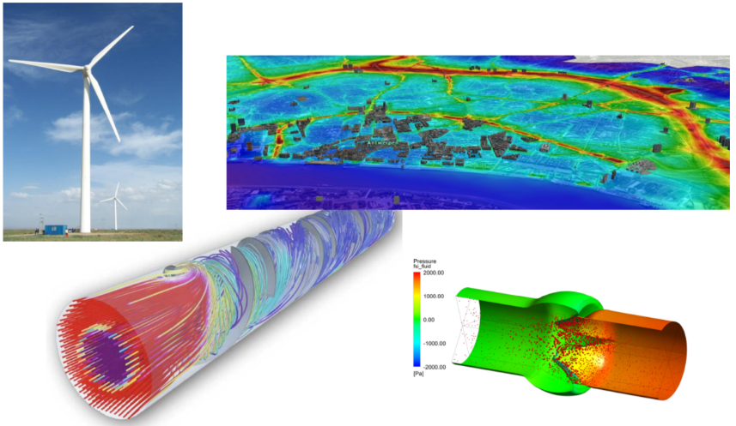
Scientific Applications of HPC (4/5)

Slide 11
Scientific Applications of HPC (5/5)

Slide 12
HPC Infrastructure in Cuba: Present
HPC Infrastructure at UCLV, UO & UCI
 | UCI | UO | UCLV
 |  |  | CPU | BigData
Nodes | - | 3 | 36 | 4
Cores | - | 132 | 256 | 32
RAM (GB) | - | 132 | 346 | 64
HDD (TB) | - | 1.6 | 11 | 304 GB
TFLOPS | - | 1.0 | 2.63 | Hadoop

Slide 13
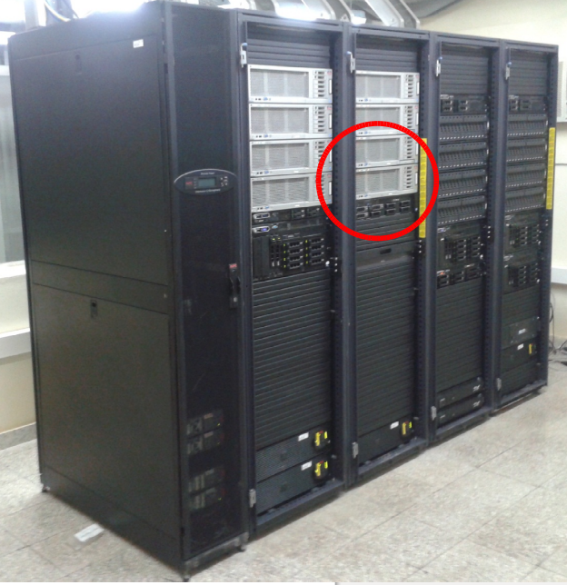
HPC in UO Datacenter

Slide 14
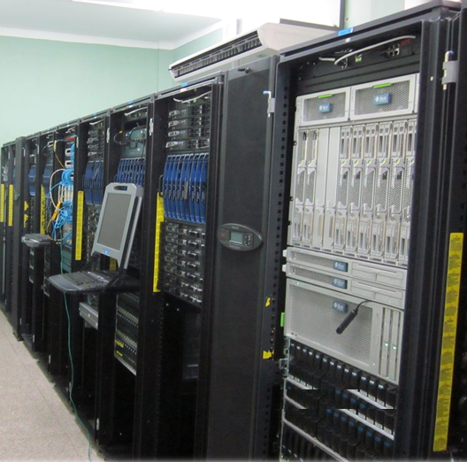
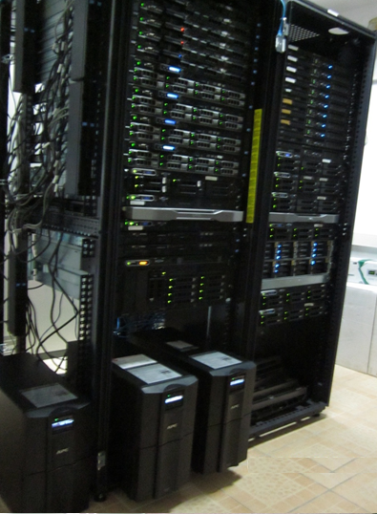
HPC in UCLV Datacenter

Slide 15
HPC Infrastructure in Cuba: NEAR FUTURE (1/2)
HPC UCLV & UCI
IBM iDataPlex
149 nodes
1192 cores
CPU's Intel Xeon Nehalem de 2.26GHz
12GB de RAM/node.
BigData UCLV (Spark)
20 nodes (80 Cores)
320 GB RAM
1.52 TB HDD + 3 TB NAS
Summarizing HPC each university:
75 nodes with almost 600 cores & 1TB RAM

Slide 16
HPC Infrastructure in Cuba: NEAR FUTURE (2/2)
HPC UO
9 x Dell PowerEdge C6145 (near future: 16)
2 motherboards each one: 18 nodes
16 cores/node
CPU's AMD "Magny-Cours" 2.4Ghz
64GB RAM/node
Switch Infiniband 2xQDR
Summarizing:
288 cores & 1.15TB RAM

Slide 17
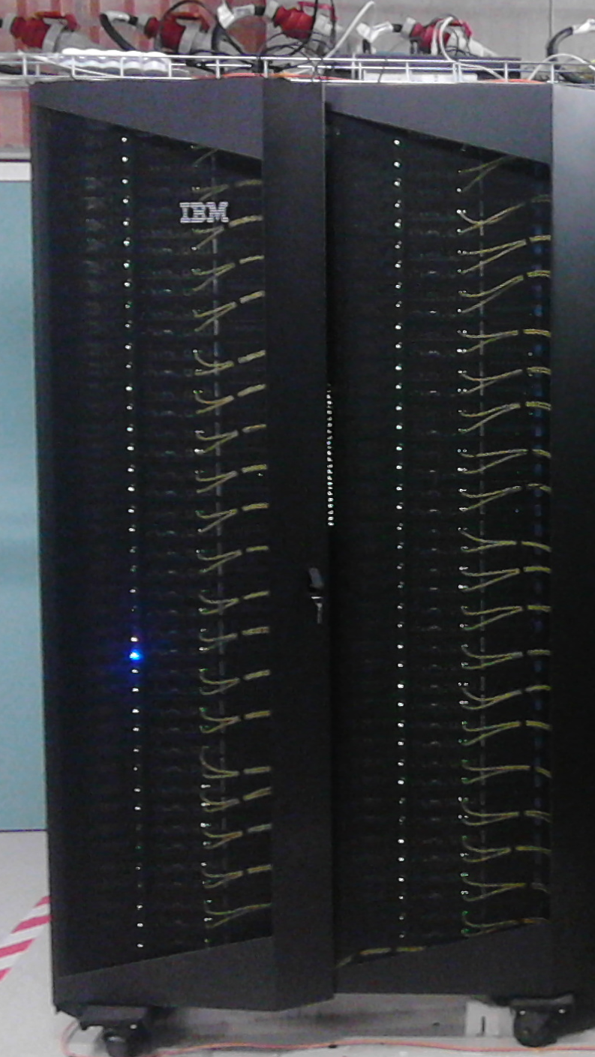
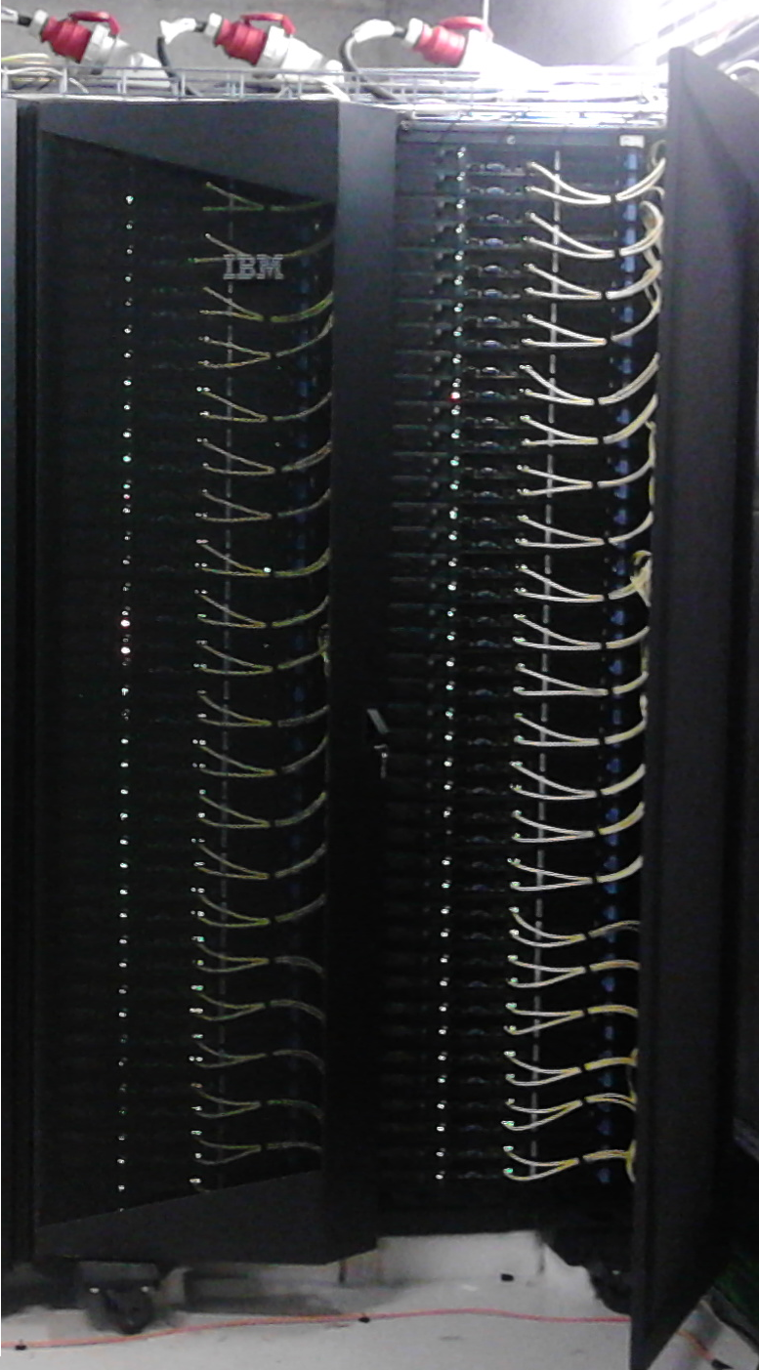
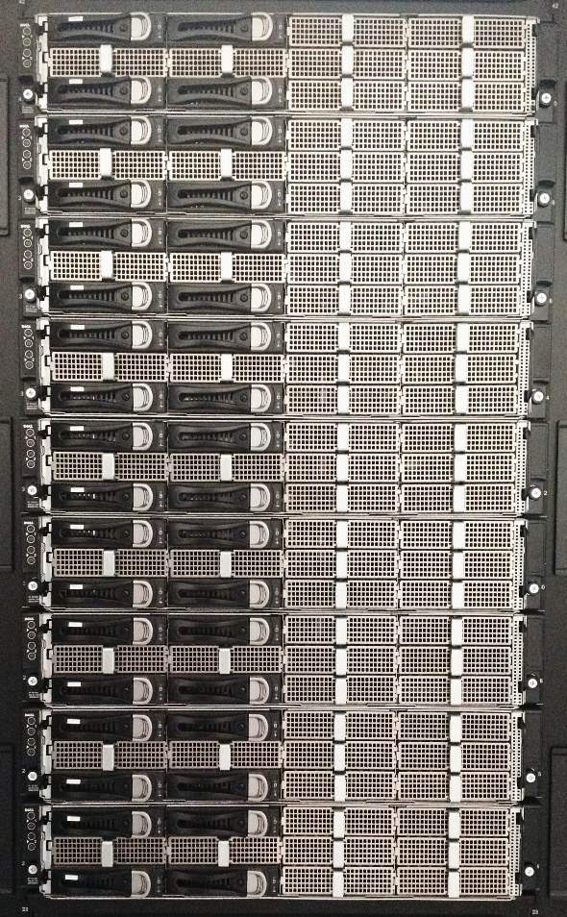
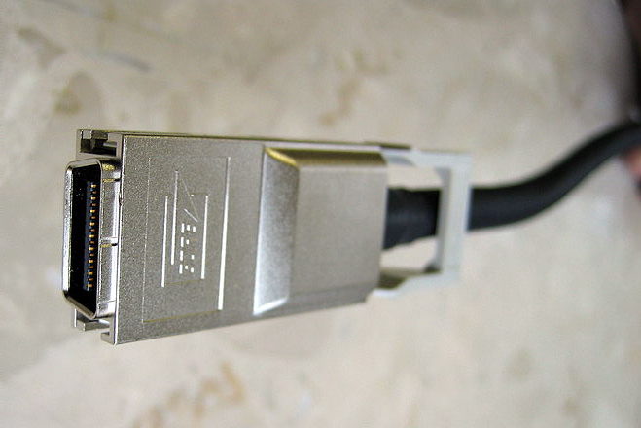
NEAR FUTURE (CPU)
UCLV
UCI
UO

Slide 18
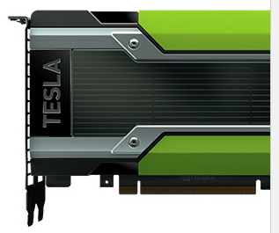
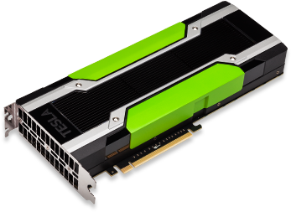
NEAR FUTURE (GPU)
Tesla K80 Accelerator Features and Benefits
4992 NVIDIA CUDA cores with a dual-GPU design
Up to 2.91 Teraflops double-precision performance with NVIDIA GPU Boost
Up to 8.73 Teraflops single-precision performance with NVIDIA GPU Boost
24 GB of GDDR5 memory
480 GB/s aggregate memory bandwidth
Server-optimized to deliver the best throughput in the data
Server DELL R730 (128 GB RAM, 8 C 2.4 GHz, 3 TB HDD)

Slide 19
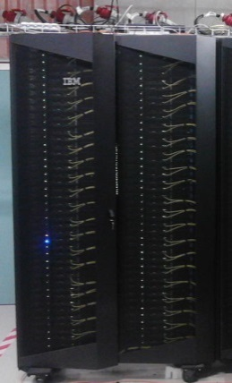
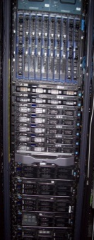
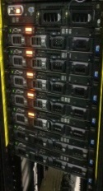
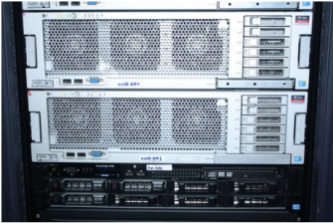
Near Future Centers with HPC infrastructure
2016

Slide 20
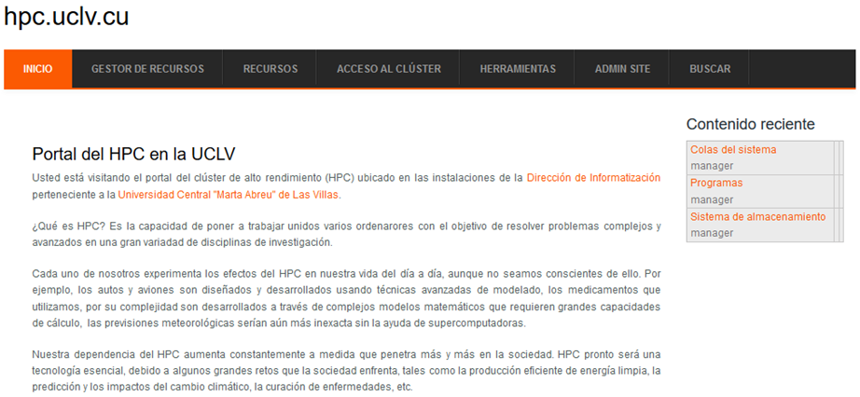
Firsts Results

Slide 21
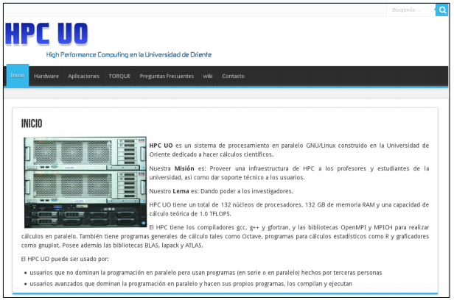
Firsts Results

Slide 22
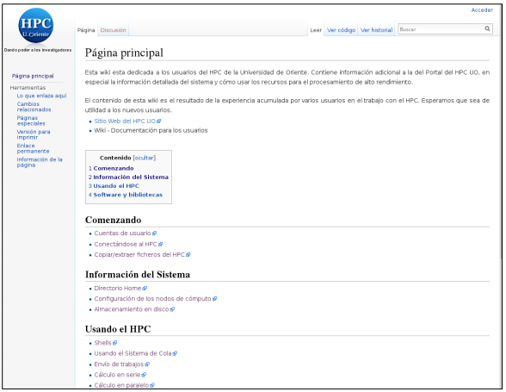

Slide 23
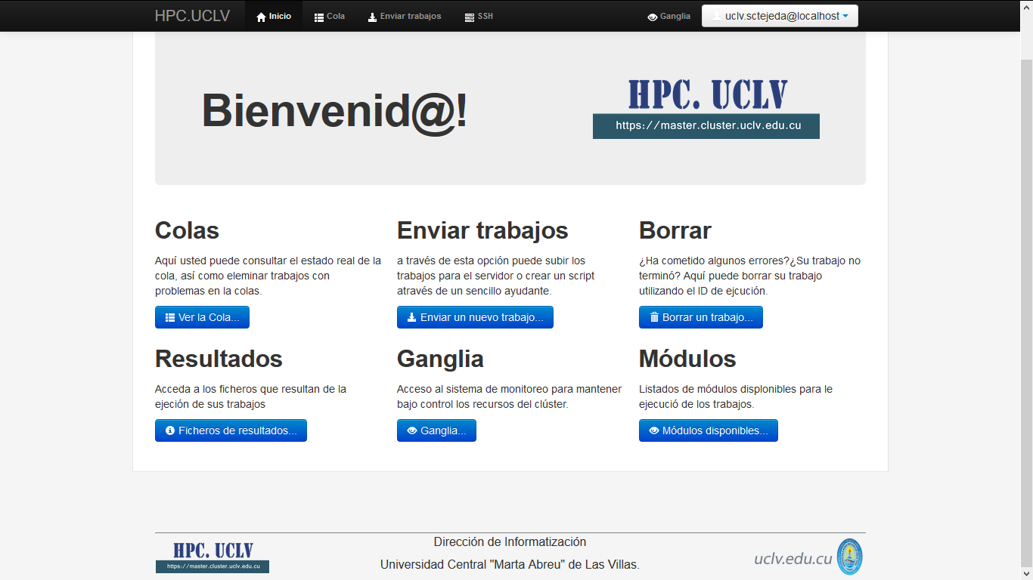
Ways to access

Slide 24
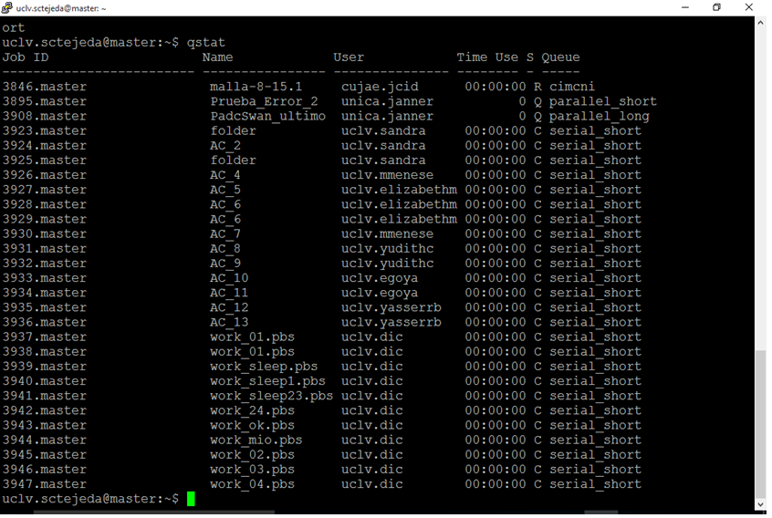
Queues state via SSH

Slide 25
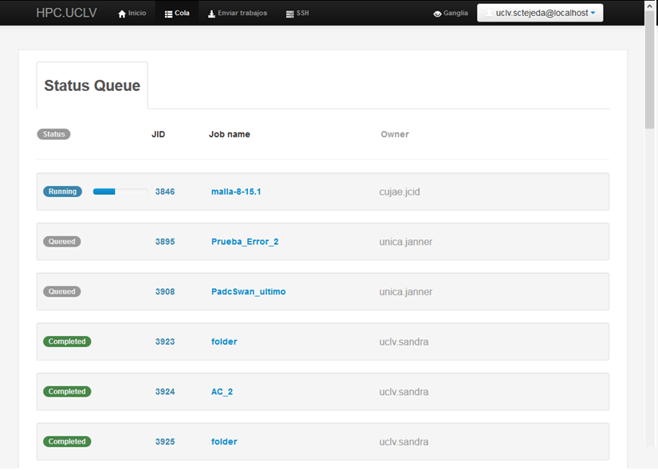
Queues state via Web

Slide 26
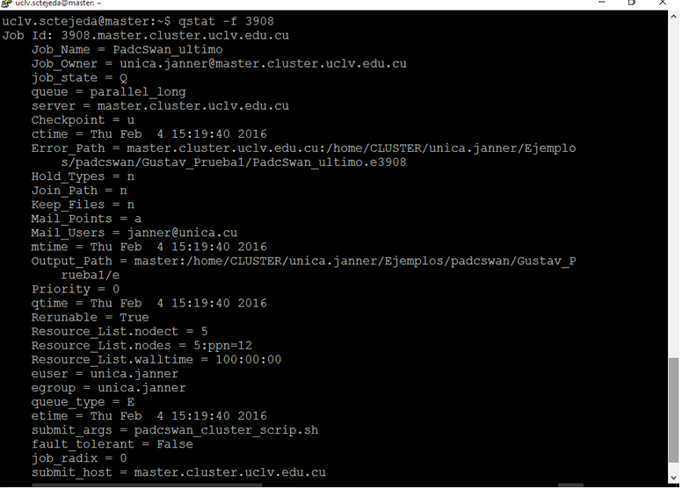
Job state via SSH

Slide 27
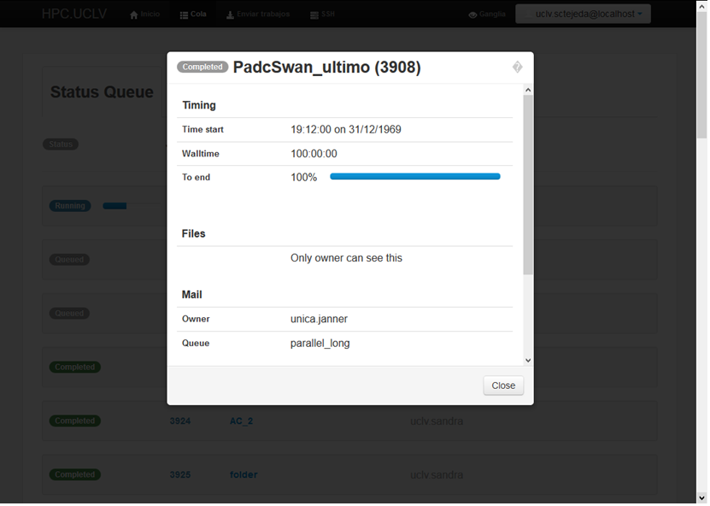
Job state via Web

Slide 28
Script via ssh

Slide 29
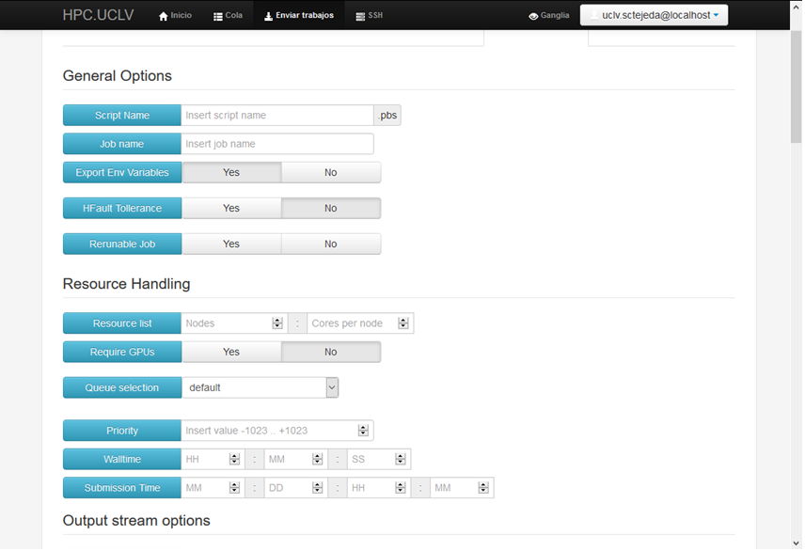
Script via Web

Slide 30
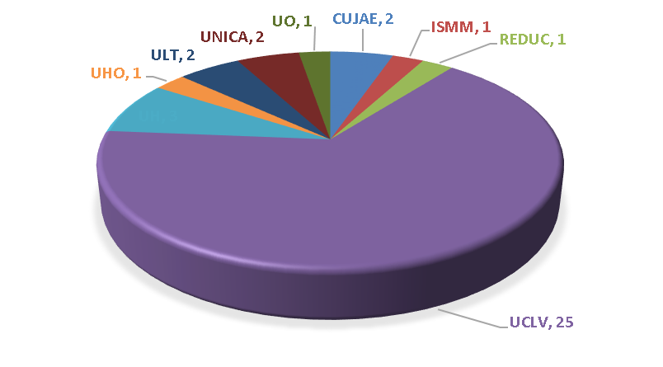
Results
Research groups using UCLV HPC facilities

Slide 31
National Strategy (1/2)
Heterogeneous Setup:
HPC depending on job: more cores or more RAM/core, faster network,...
CPU Vs GPU
Specialization in BigData

Slide 32
National Strategy (2/2)
Strengthen sysadmin capacity
Dedicated HPC group in each university (UCI, UCLV, UO)
Workshops, presentations, trainings with Belgian experts
Build-up national user base
Workshops for potential HPC users
Dialogue with researchers to identify needs & ideas
Identify potential partners: MES, pharma, research, hospitals,...
Facilitate remote access
Join international HPC community: Development of EasyBuild

Slide 33
HPCUGENT.GITHUB.COM/EASYBUILD
Easy installation of software on HPC
Automatic resolving of dependencies
International development community, trainings, conferences,...
Open Source, Free Software
We need Cuban developers to join!
EasyBlocks
$ eb --list-easyblocks
EasyBlock
|-- Binary
| |-- EB_ABAQUS
| |-- EB_Allinea
| |-- EB_CPLEX
| |-- EB_CUDA
| |-- EB_EPD
| |-- PackedBinary
| | |-- EB_Java
| | |-- EB_Tornado
| |-- EB_Mathematica
| |-- Rpm
| | |-- EB_QLogicMPI
| |-- JAR
|-- EB_ACML
|-- EB_ALADIN
|-- EB_ANSYS
|-- EB_ant

Slide 34
Get Involved!
Our Vision:
To Make Supercomputing services available to all Cuban scientists
Our Mission:
Provide centralized HPC infrastructure, training and support for researchers from MES Universities, Scientific Institutions,...
You are invite to formulate HPC proposals!!!
Contact information:
oau@uo.edu.cu (Oscar Au Alvarez)
miriel@uclv.edu.cu (Miriel Martin Mesa)
cbustillo@uclv.edu.cu (Carlos Miguel Bustillo)

Slide 35
Dieter.Roefs@ugent.be
hcruz@uclv.edu.cu
Thank You

