Slide 1
A Cuban
model for
ICT4DEV
Manuel Oliver Dominguez (UCLV)
Rudy Gevaert (Ghent University)

Slide 2
ICT infrastructure
Goal of project 2
Buy/donate hardware (investments)
Increase capacity of ICT staff
Professionalize ICT services at universities
Facilitate collaboration and exchange of ideas
Support project 1 and 3 and university
17/Feb/2016
2

Slide 3
Contents
Hardware investments
ICT capacity building
IT services at university level
Collaboration at university and network level
17/Feb/2016
3

Slide 4
Infrastructure
Infrastructure plays a very important role in our network.
It’s a two way road that allow communication between partner universities and with the rest of the world.
Investments in infrastructure must be accompanied with trainings for staff and users
17/Feb/2016
4

Slide 5
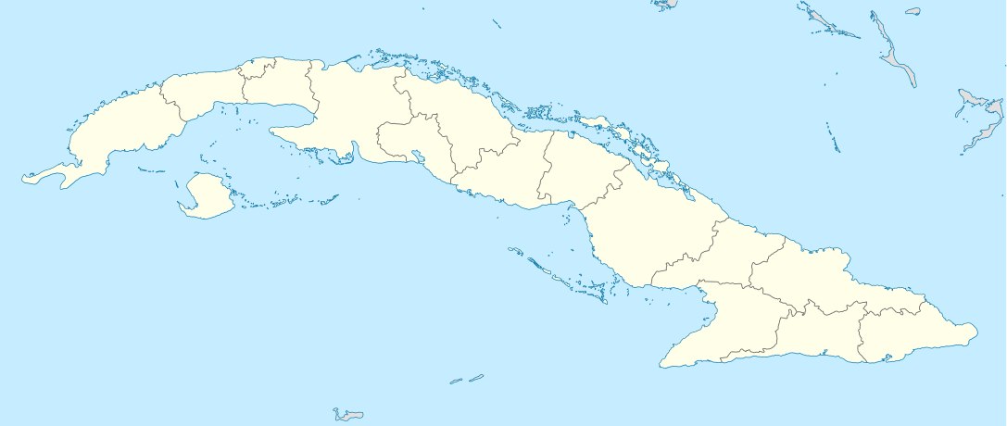
Infrastructure
17/Feb/2016
5

Slide 6
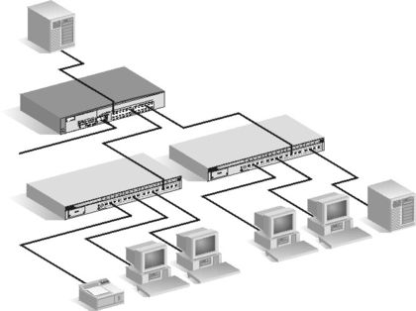
Infrastructure
Servers Room
Backbone
User room
17/Feb/2016
6

Slide 7
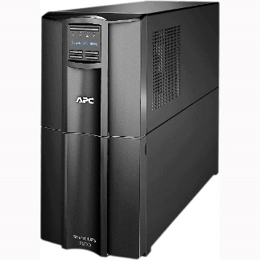
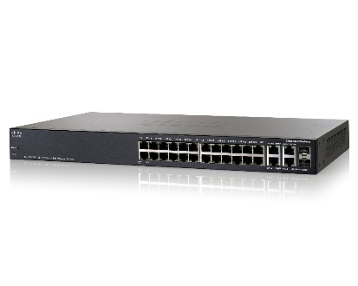
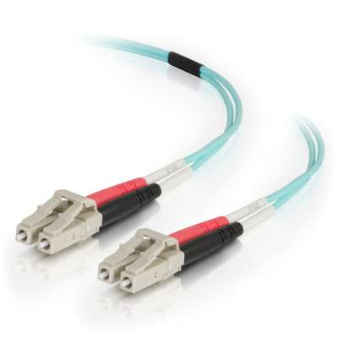
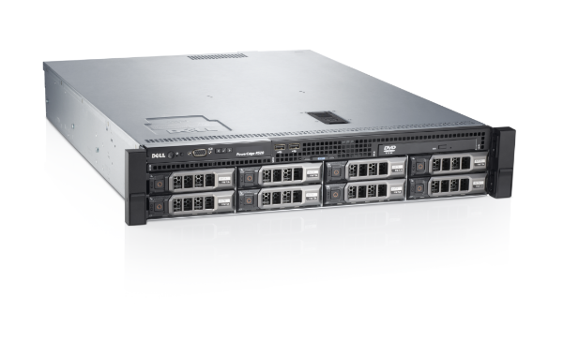
Infrastructure
Elements to cover:
Electrical support
Cooling
Network connections
Computers and Servers
17/Feb/2016
7

Slide 8
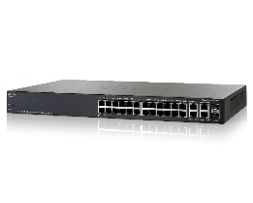
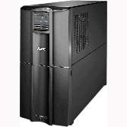
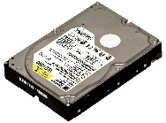
Infrastructure
Some numbers
10 x Dell servers R520. 2 CPU. 64 Gb RAM. 6 HDD 2 Tb
16 x Gigabits switches for backbone level
Temperature and humidity sensors
24 x Fast Ethernet switches with gigabits uplinks for user rooms
8 km optic fiber cable
12 UPS APC 3kva
10 km Cat5e cable
Some spare parts ( hdds , memories, batteries )
17/Feb/2016
8

Slide 9
Infrastructure
Additional inputs:
MES
Donations represent an important extra input for the network and the project.
Donators:
Gent University
Leuven Hospital
Close The Gap projects
17/Feb/2016
9

Slide 10
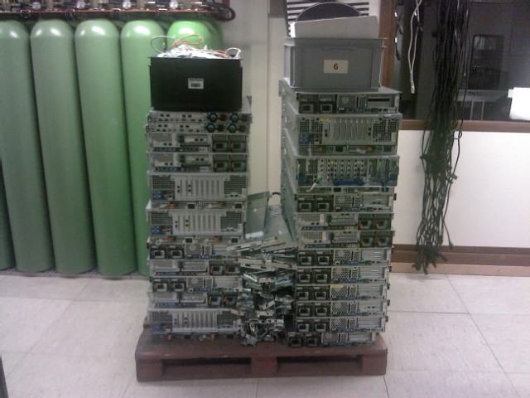
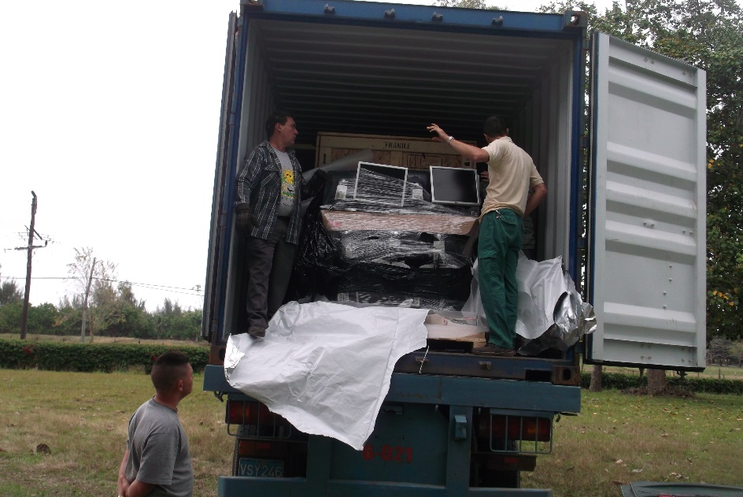
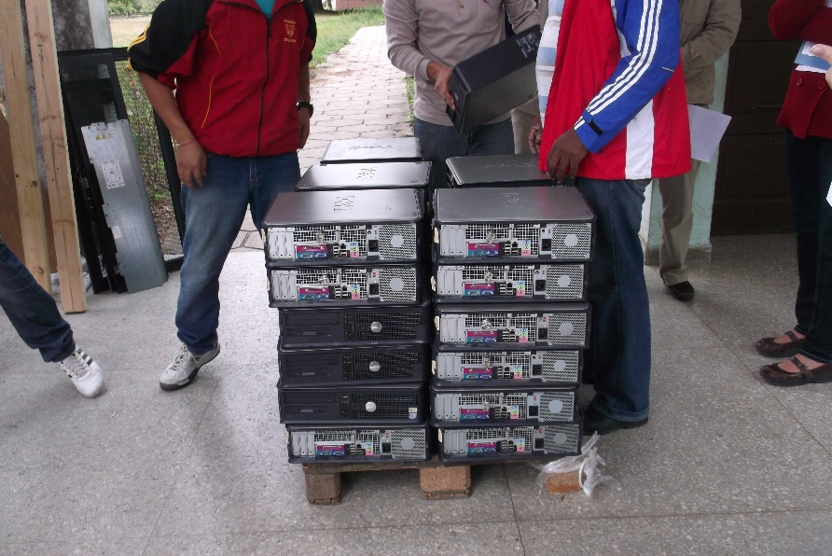
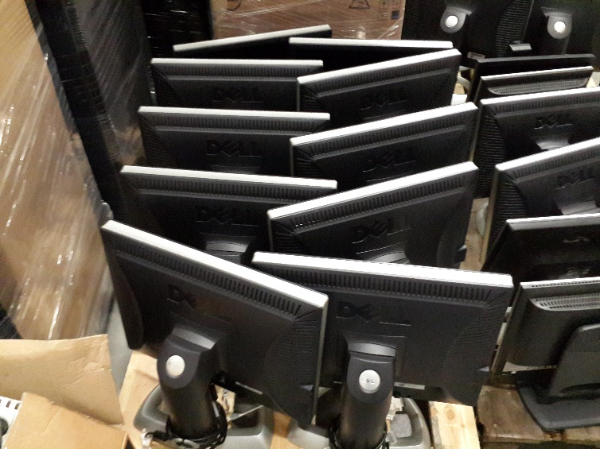
Infrastructure
17/Feb/2016
10

Slide 11
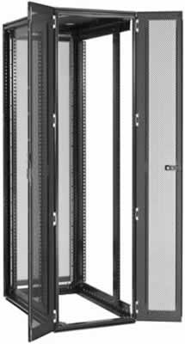
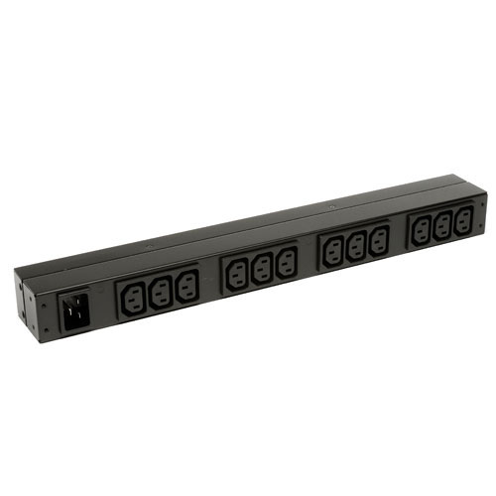
Infrastructure
More numbers
23 Dell PowerEdge for racks
172 Dell OptiPlex computers
124 Flat displays
160 USB keyboard
137 USB mouse
7 Dell Racks 40u
15 Power Distribution Units for Dell Servers
70 2Gb memory modules
Patch cords
17/Feb/2016
11

Slide 12
ICT infrastructure capacity building
With
Operations Report Card

Slide 13
Operations Report Card
32 objectives
when implemented will
increase the efficiency of the ICT office
and improve the ICT service

Slide 14
Operations Report Card
A. Public Facing Practices
B. Modern Team Practices
C. Operational Practices
D. Automation Practices
E. Fleet Management Processes
F. Disaster Preparation Practices
G. Security Practices
17/Feb/2016
14

Slide 15
Public Facing Practices
Are user requests tracked via a ticket system?
Are ``the 3 empowering policies'' defined and published?
The acceptable methods for users to request help.
The definition of ”an emergency”.
The scope of service: Who, what and where.
Does the team record monthly metrics?

Slide 16
Modern Team Practices
Do you have a ”policy and procedure” wiki?
Do you have a password safe?
Is your team’s code kept in a source code control system?
Does your team use a bug-tracking system for their own code?
In your bugs/tickets, does stability have a higher priority than new features?
Does your team write ”design docs?”
Do you have a ”post-mortem” process?

Slide 17
Operational Practices
Does each service have an OpsDoc?
Does each service have appropriate monitoring?
Do you have a pager rotation schedule?
Do you have separate development, QA, and production systems?
Do roll-outs to many machines have a ``canary process''?

Slide 18
Automation Practices
Do you use configuration management tools like cfengine/puppet/chef?
Do automated administration tasks run under role accounts?
Do automated processes that generate e-mail only do so when they have something to say?

Slide 19
Fleet Management Processes
Is there a database of all machines?
Is OS installation automated?
Can you automatically patch software across your entire fleet?
Do you have a PC refresh policy?

Slide 20
Disaster Preparation Practices
Can your servers keep operating even if 1 disk dies?
Is the network core N+1?
Are your backups automated?
Are your disaster recovery plans tested periodically?
Do machines in your data center have remote power / console access?

Slide 21
Security Practices
Do Desktops, laptops, and servers run self-updating, silent, anti-malware software?
Do you have a written security policy?
Do you submit to periodic security audits?
Can a user’s account be disabled on all systems in 1 hour?
Can you change all privileged (root) passwords in 1 hour?

Slide 22
Capacity building
Each year 4-6 people follow training in Ghent
Every two years a workshop in Cuba
2 visits of Belgian ICT experts per year

Slide 23
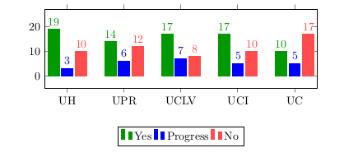
Results of workshop

Slide 24
Services
Services are not independent.
Services ⬄ Infrastructure ⬄ Users
Services failures = Loose time
Time = Money || Effort
Services are evolving continuously
Society push University
University contribute to Society
17/Feb/2016
24

Slide 25
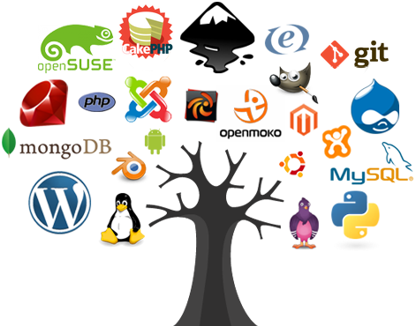
Services
Our project only supports services and applications based on free and open source code.
17/Feb/2016
25

Slide 26
Services
Basic Services
Users directories (Samba, LDAP)
Electronic mail (RedMail, Zimbra, Exim+Dovecot)
Cuban and International web access (squid)
Web sites hosting
Online learning platform (Moodle)
Programs repositories
Personal information storage (OwnCloud)
Virtualization platform (Proxmox)
Helpdesk
17/Feb/2016
26

Slide 27
Services
Basic Services
Instant messaging (Jabber)
Monitoring (Mrtg, Munin, Nagios)
Git (GitLab)
New Services
Logs processing
Backups
Automatic installations
Video conference
17/Feb/2016
27

Slide 28
Services
Future Services
Automatic configuration management (Puppet)
A central authentication system for university students and staff
A distribute search engine running at partner universities.
17/Feb/2016
28

Slide 29
Services
Trainings
11 training of one month in Belgium
Workshops
2 workshops for 23+25 members of staff
Visits
3 one-week visits to partners universities
17/Feb/2016
29

Slide 30
Services
Sharing results through Virtual Machines appliances
Network Installation system (UCLV)
Intranet search engine (UPR)
Documentation on the project Wiki
http://redtic.uclv.cu/dokuwiki/
17/Feb/2016
30

Slide 31
Facilitate collaboration and exchange of ideas by using

Slide 32
What is DevOps?
DevOps is a cultural and professional movement (since 2007)
It is not a job description, new team, or solitary organization
It's not a product
A way to Align Developers and Operations (sys and network administrators)
Means to remove the barriers between devs and ops.
Method to increase quality
Method to Decrease Cycle time

Slide 33
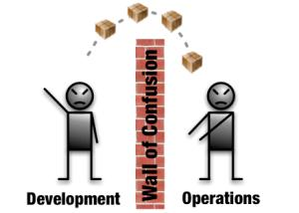
Traditional IT department

Slide 34
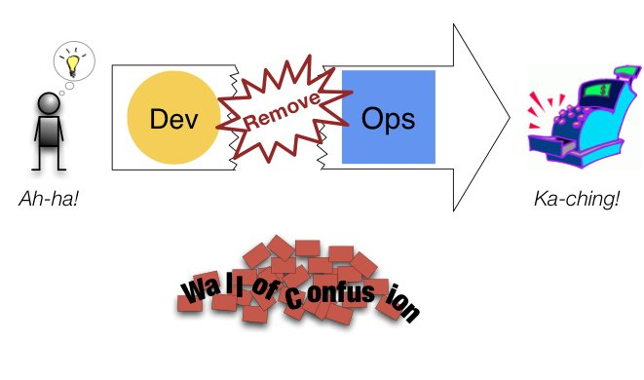
DevOps!

Slide 36
Culture
DevOps is mostly about breaking down barriers between teams
Remove bottlenecks
Remove wait time
Sharing values and behaviors
Supportive
Flexible
Collaborative
Trusting

Slide 37
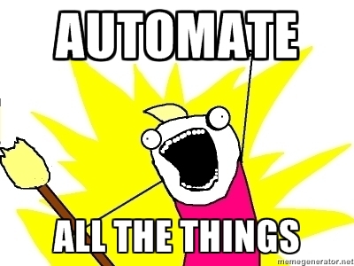
Automation
Most visible part of DevOps
Increases productivity
Prevents defects
Creates consistency
Enable self-service

Slide 38
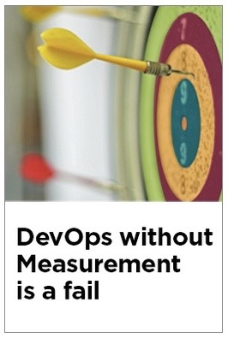
Measurement
Measure “Everything”
Continuous improvement goes together
with measuring the improvement
How can you otherwise know if the
automation makes sense?
Data based decisions, not on instinct
Data should be transparent, accessible
to all, meaningful, and able to be visualized in an ad hoc manner.

Slide 39
Sharing
Key to success at any organization is sharing the tools, discoveries, and lessons.
By finding people with similar needs across the organization, new opportunities to collaborate can be discovered, duplicate work can be eliminated, and a powerful sense of engagement can be created among the staff.
Outside the organization, sharing tools and code with people in the community helps get new features implemented in open source software quickly.
Conference participation leaves staff feeling energized and informed about new ways to innovate.

Slide 40
Future?!
DevOps Workshop for
VLIR-UOS partners (Peru, Ecuador, Bolivia)
Cuban ICT professionals outside of Network:
Enterprises
Ministries
Other universities
Proposal submitted to VLIR-UOS

Slide 41
Thank You
Rudy.Gevaert@ugent.be
moliver@uclv.edu.cu

